Slide 1
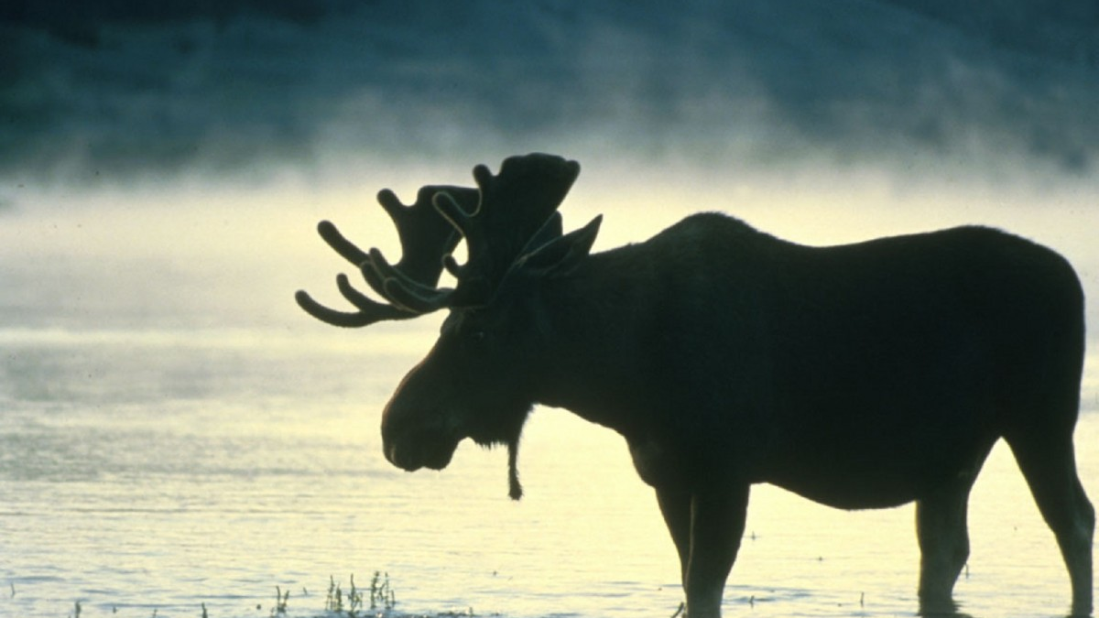
MEMORIAL SERVICE
WILLISTON MOOSE LODGE #239
REMEMBERING OUR DEPARTED BROTHERS AND SISTERS OF OUR LODGE
2022-2023

Slide 2

“When someone becomes a memory, the memory becomes a treasure.”

Slide 3
IN LOVING MEMORY
Allen Allard
Linda Beard
Donna Bilquist
Walter Z. Brown
Roger W. Chewerda
Ernie C. Dawson
Robin Falcon
Curtis A. Hansen
Vernon Herfindahl

Slide 4
IN LOVING MEMORY
Keith Johnsrud
Darlene Langseth
Shirley Ledahl
Eleanor Metzler
Barb Poeckes
Joshua Romans
Sandra Sanders
Winifred Schiele
Floyd Semenko

Slide 5
IN LOVING MEMORY
Don Sillerud
Jerry Stordahl
Alfreda Thompson
Harold Tofte
Jackie Wahlstrom

Slide 6
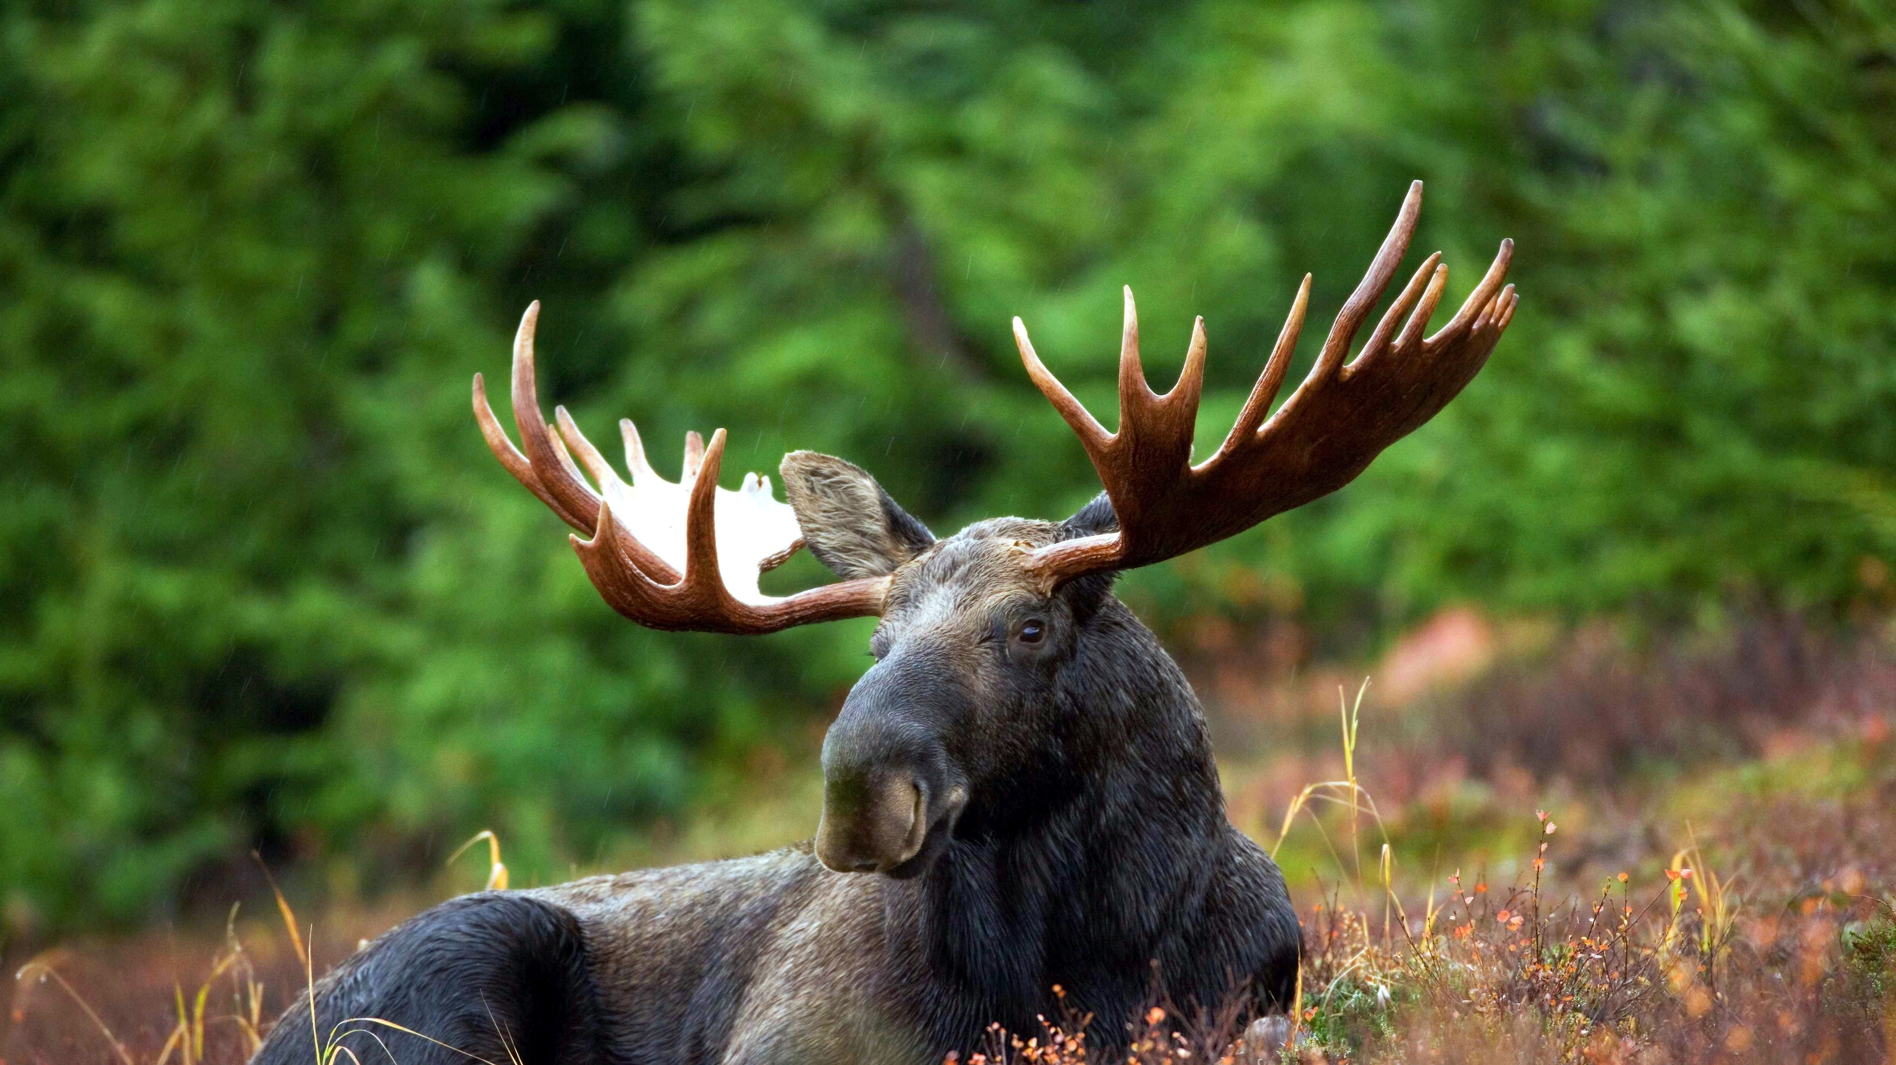
Thanks for coming to honor our departed Brothers and Sisters of the Williston Moose Lodge!

